Slide 1
Lesson 6: Inheritance and Polymorphism
by Dr. Shafqat Ali Shad

Slide 2
Wholeness of the Lesson
Java supports inheritance between classes in support of the OO concepts of inherited types and polymorphism. Interfaces support encapsulation, play a role similar to abstract classes, and provide a safe alternative to multiple inheritance. Likewise, relationships of any kind that are grounded on the deeper values at the source of the individuals involved result in fuller creativity of expression with fewer mistakes.

Slide 3
Introduction to Inheritance
Definition. A class Subclass inherits from another class Superclass if objects of type Subclass have automatic access to the "available" methods and variables that have been defined in class Superclass. By "automatic access" we mean that no explicit instantiation of (or reference to) the class Superclass is necessary in order for objects of type Subclass to be able to call methods defined in class Superclass. By "available" methods and variables, we mean methods and variables that have been declared either public or protected (or have package level access if in the same package)

Slide 4
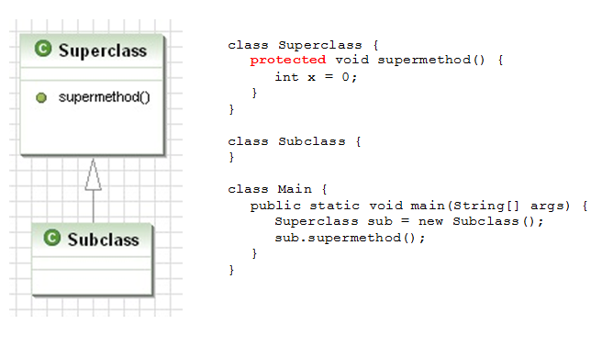
Introduction to Inheritance

Slide 5
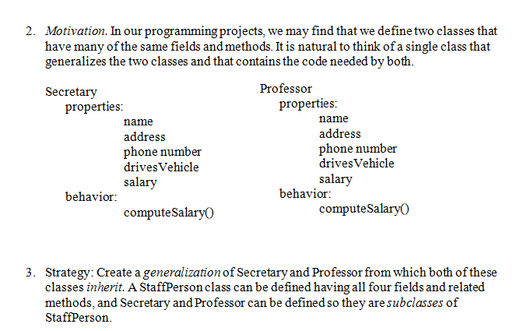
Introduction to Inheritance

Slide 6
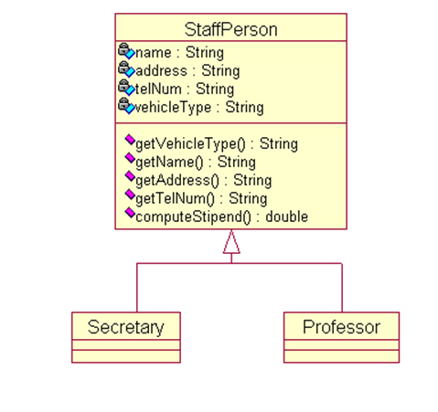
Introduction to Inheritance

Slide 7
Introduction to Inheritance
When the classes have this relationship, we may view the type of an instance of a subclass as being that of the superclass. For example, we can instantiate like this:
StaffPerson person1 = new Professor():
StaffPerson person2 = new Secretary();
This is similar in spirit to the automatic conversions that are done for primitive types:
byte b = 8;
int k = b;

Slide 8
An Example of Superclass and Subclass
The Manager subclass of Employee
//Employee class, as defined in previous lessons
class Employee {
//constructor
Employee(String aName,
double aSalary,
int aYear,
int aMonth,
int aDay) {
name = aName;
salary = aSalary;
hireDay = LocalDate.of(aYear,aMonth,aDay);
}
// instance methods
public String getName() {
return name;
}
public double getSalary() {
return salary;
}
public LocalDate getHireDay() {
return hireDay;
}
public void raiseSalary(double byPercent) {
double raise = salary * byPercent / 100;
salary += raise;
}
//instance fields
private String name;
private double salary;
private LocalDate hireDay;
}

Slide 9
An Example of Superclass and Subclass
class Manager extends Employee {
public Manager(String name, double salary, int year,
int month, int day) {
super(name,salary,year,month,day);
bonus = 0;
}
@Override
public double getSalary() {
//no direct access to private variables of superclass
double baseSalary = super.getSalary();
return baseSalary + bonus;
}
public void setBonus(double b) {
bonus = b;
}
private double bonus;
}

Slide 10
An Example of Superclass and Subclass
class ManagerTest {
public static void main(String[] args) {
Manager boss = new Manager("Boss Guy", 80000, 1987, 12, 15);
boss.setBonus(5000);
Employee[] staff = new Employee[3];
staff[0] = boss;
staff[1] = new Employee("Jimbo", 50000, 1989, 10, 1);
staff[2] = new Employee("Tommy", 40000, 1990, 3,15);
//print names and salaries
for(Employee e : staff) {
System.out.println("name: " + e.getName() +
"salary: "+ e.getSalary());
}
}

Slide 11
Points to observe:
A. Manager provides all the "services" of Employee, with additional functionality (involving bonuses) and overridden functionality (getSalary method) – so it's a good candidate for extending Employee.
B. We use the extends keyword to indicate that Manager is a subclass of Employee
C. A Manager instance can freely use the getName and getHireDay methods of its superclass Employee – no need to re-code these methods. However, special methods that are unique to Manager (in particular, the setBonus method) cannot be called on an Employee instance.
Manager m = new Manager(. . .);
m.getName(); //ok
m.setBonus(5000); //ok
Employee e = new Employee(. . .);
e.getName(); //ok
e.setBonus(5000); //compiler error

Slide 12
Points to observe:
We override the getSalary method in the Manager class. This means that the method is defined differently from its original version in Employee. A Manager object computes salary differently from Employee objects.
In this case we want to use the Employee version of getSalary, but we want to add to that value any possible bonus that the Manager has. How to access the superclass version of getSalary from within the subclass Manager?
Use super to indicate that you are accessing the superclass version.
Best Practice Use the @Override annotation to make it clear that getSalary is being overridden. Two reasons to do so:
It is possible for another user of your code not to realize that your method overrides a method in a superclass.
It is also possible to intend to override a method in a superclass but to accidentally use a slightly different signature (in which case the method will not be overridden). With the @Override annotation, this mistake will be caught by the compiler. Example: Overriding the equals method (see below)

Slide 13
Points to observe:
WIn the Manager constructor, we wish to reuse the constructor that is found in Employee, but we also want to include more code. This is accomplished by using the super keyword again (but it has a different meaning here).
Like this in constructor, the use of super must occur on the first line of the constructor body.
Polymorphic types. The 0th element of the staff array was defined to be of type Manager, yet we placed it in an array of Employee objects. The fact that an object variable can refer to an object of a given type as well as objects that belong to subtypes of the given type is called polymorphism.
Dynamic binding. When the getSalary method is called on staff[0], the version of getSalary that is used is the version that is found in the Manager class. This is possible because the JVM keeps track of the actual type of the object when it was created (that type is set with execution of the "new" operator). The correct method body (the version that is in Manager) is associated with the getSalary method at runtime – this "binding" of method body to method name is called late binding or dynamic binding.

Slide 14
MAIN POINTS
One class (the subclass) inherits from another class (the superclass) if all proteced and public data and methods in the superclass are automatically accessible to the subclass, even though the subclass may have additional methods and data not found in the superclass. Java supports this notion of inheritance. In Java syntax, a class is declared to be a subclass of another by using the extends keyword. Likewise, individual intelligence "inherits from" cosmic intelligence, though each "implementation" is unique.

Slide 15
Points to observe:
Right use of inheritance.
Manager IS-A Employee – it's not just that the two classes have some methods in common, but a manager really is an employee. This helps to verify that inheritance is the right relationship between these classes.
Substitution principle. Another test is: Can a Manager instance be used whenever an Employee instance is expected? The answer is yes, since every manager really is an employee, and partakes of all the properties and behavior of an employee, though managers support extra behavior.

Slide 16
MAIN POINTS
As a matter of good design, a class C should not be made a subclass of a class D unless C "IS-A" D. Likewise, individual intelligence "is" cosmic intelligence, though this relationship requires time to be recognized as true.

Slide 17
Rules for Subclass Constructors
a subclass constructor must make use of
one of the constructors from its superclass
The reason for the rule is that the state of the superclass (values of its instance variables) should be set by the superclass (not the subclass); so during construction, the subclass must request the superclass to first set its state, and then the subclass may perform further initialization of its own state.
We saw this rule at work in the Employee/Manager example:
class Employee{
Employee(String name, double salary, int y, int m, int d){
//…//
}
}
class Manager extends Employee {
Manager(String name, double salary, int y, int m, int d) {
super(name,salary,y,m,d); //makes use of superclass constructor
}
}

Slide 18
Rules for Subclass Constructors
It is not necessary for any of the subclass constructors to have the same signature as any of the superclass constructors. However, each of the subclass constructors must access one of the superclass constructors in its implementation.
class Employee{
Employee(String name, double salary, int y, int m, int d){
//…//
}
}
class Manager extends Employee {
Manager(String name, double salary, double bonus,//different but ok
int y, int m, int d) {
super(name,salary,y,m,d);
this.bonus = bonus;
}
}

Slide 19
Rules for Subclass Constructors
The subclass may make use of the implicit (default) constructor only if either
the no-argument constructor of the superclass has been explicitly defined, OR
no constructor in the superclass is explicitly defined
In either of these cases, the subclass may make use (possibly implicitly) of the superclass' default constructor.

Slide 20
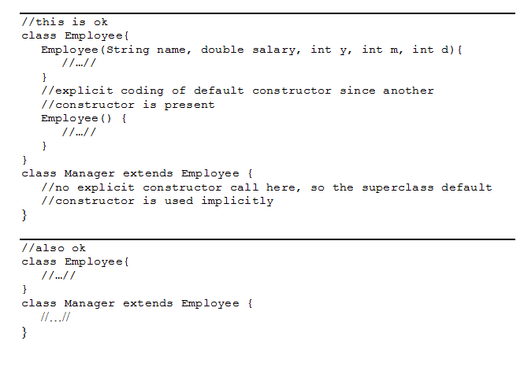
Rules for Subclass Constructors

Slide 21
Inheritance and the Object Class
In Java, there is a class called Object. Every class created in Java (either in the Java libraries, or user-defined) belongs to the inheritance hierarchy of Object.
For example:
class MyClass {
}
This MyClass class automatically inherits from Object, even though we do not write syntax that declares this fact.
In later slides, we will discuss the (primarily public) methods that belong to Object, and that are therefore inherited by every class in Java.

Slide 22
Inheritance and the Object Class
Using the instanceof operator to check type.
The following code returns true:
"Hello" instanceof java.lang.String
In general, you can query Java about the type of any runtime object by using instanceof. The general synatx is
ob instanceof <classname>
where ob is of type Object (or any subtype). This expression will return true if the runtime type of ob really is of the specified type, or if the class of ob is a subclass of (or a subclass of a subclass of…etc) the specified type. Therefore, for example, if e is an instance of Employee and s is a String, both of the following are true
e instanceof Object
s instanceof Object
Whenever the instanceof operator returns true, the object on the left side of the expression can be viewed as having type indicated on the right side (via polymorphic type assignment). So in this example, we could type e and s above as Objects:
Object ob_e = e;
Object ob_s = s;

Slide 23
Two Ways Inheritance Arises
We saw Manager was a natural choice for a subclass of Employee because it extends Employee's behavior.
Another situation that gives rise to inheritance occurs when several classes are seen to naturally belong to the same general type – this is generalization. In the "figures" example (next slide), it seems natural to generalize the curves Triangle, Circle, Square

Slide 24
Two Ways Inheritance Arises
final class Triangle {
/* we require height <= base */
final double base;
final double height;
/* we require side1 <= side2 <= side3 */
final double side1, side2, side3;
Triangle(double base, double height){
if (height <= base) {
this.base = base;
this.height = height;
}
else {
this.base = height;
this.height = base;
}
side1 = height;
side2 = base;
side3 = Math.sqrt(base * base + height * height);
assert(side1 <= side2 && side2 <= side3);
assert(height <= base);
}
Triangle(double s1, double s2, double s3) {
double[] arr = {s1, s2, s3};
Arrays.sort(arr);
double x = arr[0];
double y = arr[1];
double z = arr[2];
if(x + y < z) {
throw new IllegalArgumentException("Inputs to Triangle " + "are invalid."
}
side1 = x;
side2 = y;
side3 = z;
double u = (y * y - x * x + z * z)/(2 * z);
double h = Math.sqrt(y * y - u * u);
base = z;
height = h;
assert(side1 <= side2 && side2 <= side3);
assert(height <= base);
}
double computeArea() {
return (0.5 * base * height);
}
}

Slide 25
Two Ways Inheritance Arises
final class Square {
final double side;
Square(double side) {
this.side = side;
}
double computeArea() {
return(side*side);
}
}
final class Circle {
final double radius;
Circle(double radius) {
this.radius = radius;
}
double computeArea() {
return (Math.PI * radius * radius);
}
}

Slide 26
Two Ways Inheritance Arises
//Illustrates a non-OO (= bad) way of computing areas
class Test {
public static void main(String[] args) {
Object[] objects = {new Triangle(5,5,5),
new Square(3),
new Circle(3)};
//compute areas
for(Object o : objects) {
if(o instanceof Triangle) {
Triangle t = (Triangle)o;
System.out.println(t.computeArea());
}
if(o instanceof Square) {
Square s = (Square)o;
System.out.println(s.computeArea());
}
if(o instanceof Circle) {
Circle c = (Circle)o;
System.out.println(c.computeArea());
}
}
}
}

Slide 27
Two Ways Inheritance Arises
Notice we can arrange Triangle, Square, Circle into an array of type Object[] by polymorphism. But Object does not have a computeArea method, so we cannot polymorphically compute areas by using a single superclass method computeArea.
Instead, if we use an array Object[], we have to repeatedly test the type of the Object in the area in order to execute the correct computeArea method (using the instanceof operator).

Slide 28
Two Ways Inheritance Arises
Can generalize the behavior of these geometric shape classes to support polymorphic access to a general computeArea method.
abstract class ClosedCurve {
abstract double computeArea();
}
final class Triangle extends ClosedCurve {….}
final class Square extends ClosedCurve {
final class Circle extends ClosedCurve {

Slide 29
Two Ways Inheritance Arises
//This is the OO (= good) way of computing areas
class Test {
public static void main(String[] args) {
ClosedCurve[] objects = {new Triangle(5,5,5),
new Square(3),
new Circle(3)};
//compute areas
for(ClosedCurve cc : objects) {
System.out.println(cc.computeArea());
}
}
}

Slide 30
Two Ways Inheritance Arises
If a class is declared abstract, it cannot be instantiated.
If a method is declared abstract, it cannot have a body -- it can only be declared.
If a class has at least one abstract method, the class must be declared abstract.
A subclass of an abstract class must implement (provide method bodies for) every abstract method in its superclass (or else declare unimplemented methods abstract).
An abstract class is used to declare "services" that it provides. Any subclass of an abstract class promises to make those services available, though different subclasses may accomplish this in different ways (the method computeArea is an example of this).
Abstract classes may include instance variables and other non-abstract (implemented) methods.

Slide 31
Two Ways Inheritance Arises
In our Swing applications, the top-level GUI class is a subclass of JFrame. Recall that for our examples in class we had
public class MyFrame extends JFrame {
. . .
}
and
public class UserIO extends JFrame {
. . .
}

Slide 32
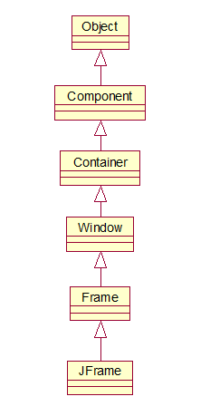
Inheritance Hierarchy for JFrame

Slide 33
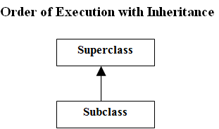
Order of Execution with Inheritance
Suppose, as in a typical case, we have Subclass as a subclass of Superclass. When we run
new Subclass()
the sections of the code are executed according to the following scheme:

Slide 34
Order of Execution with Inheritance
In Superclass, all static variables are initialzed and all static initialization blocks are run, in the order in which they appear in the file.
In Subclass, all static variables are initialized and static initialization blocks are run, in the order in which they appear in the file.
In Superclass, all instance variables are initialized and all object initialization blocks are run, in the order in which they appear in the file
In Superclass, the (relevant) constructor is run.
In Subclass, all instance variables are initialized and all object initialization blocks are run, in the order in which they appear in the file
In Subclass, the (relevant) constructor is run.

Slide 35
Java Interfaces
A Java interface is like an abstract class execpt:
No instance variables (other than variables declared final) or implemented
methods can occur An interface is declared using the interface keyword, not the class keyword
A class that implements an interface uses the implements keyword rather than the
extends keyword Can implement more than one interface. Syntax:
MyClass implements Intface1, Intface2, Intface3
Can also extend and implement. Syntax:
MyClass extends SuperClass implements Intface1, Intface2
However, no class can have more than one superclass. (Multiple inheritance not supported)
In the example, ClosedCurve could have been made an interface. The code
would have looked like this:

Slide 36
Java Interfaces
public interface ClosedCurve {
double computeArea();
}
class Triangle implements ClosedCurve {….}
class Square implements ClosedCurve {…..}
class Circle implements ClosedCurve {…..}

Slide 37
Java Interfaces
class Test {
public static void main(String[] args) {
ClosedCurve[] objects = {new Triangle(5,5),
new Square(3),
new Circle(3)};
//compute areas
for(ClosedCurve cc : objects) {
System.out.println(cc.computeArea());
}
}
}
Note! This example illustrates the fact that a class that implements an interface may be cast as the type of that interface. A simple instance of this, like the example above, would be:
ClosedCurve cc = new Rectangle(2,4);

Slide 38
Examples of Interfaces in Swing
An important example of interfaces in Swing is the way we must implement listeners in
the event-handling model:
class MyButtonListener implements ActionListener {
public void actionPerformed(ActionEvent evt){
. . . . .
}
}
ActionListener has only one method in its interface (see Java docs) – actionPerformed. So, this is the only method that must be implemented by MyButtonListener, and by other typical user-created listener classes.
Anonymous Inner Classes We cannot directly create an instance of an interface, but we have seen how it is possible to create an instance “on the fly” using anonymous inner classes.
button.addActionListener(new ActionListener() {
public void actionPerformed(ActionEvent evt) {
Sytem.out.println(“Button height = “ + button.getSize().height);
text.setText(“button press”);
}
});

Slide 39
MAIN POINT
Interfaces are used in Java to specify publicly available services in the form of method declarations. A class that implements such an interface must make each of the methods operational. Interfaces may be used polymorphically, in the same way as a superclass in an inheritance hierarchy. Because many interfaces can be implemented by the same class, interfaces provide a safe alternative to multiple inheritance. The concept of an interface is analogous to the creation itself – the creation may be viewed as an “interface” to the undifferentiated field of pure consciousness; each object and avenue of activity in the creation serves as a reminder and embodiment of the ultimate reality.

Slide 40
Thank you

